Slide 1


Trento, 02 December 2020
Ph.D. Student: Chiara Nardin
chiara.nardin@unitn.it
Probabilistic
Seismic Hazard & Fragility Analysis
Hands-on: Matlab Tutorials
Ph.D. Student Chiara Nardin – M.Sc., Eng. in Civil Engineering

Slide 2
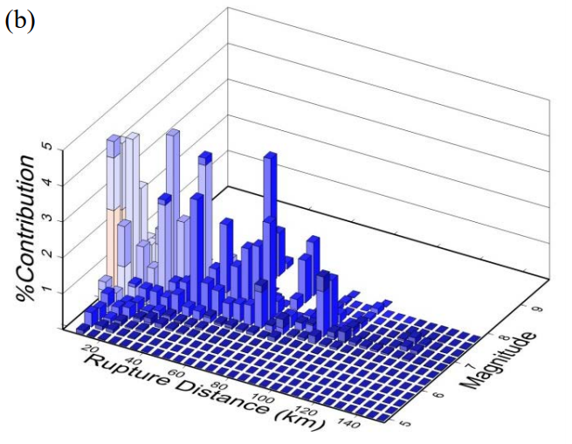
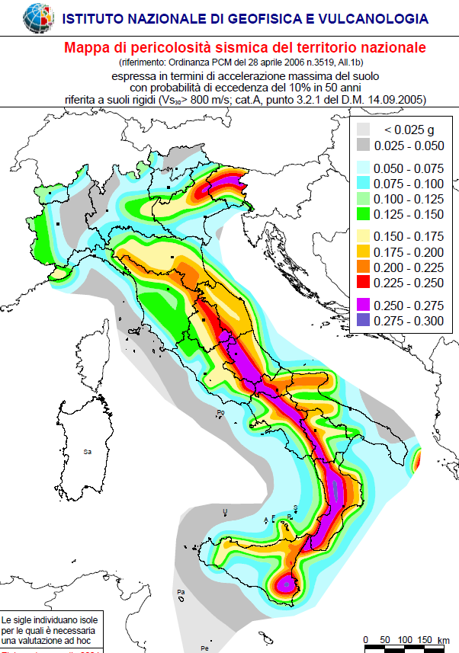
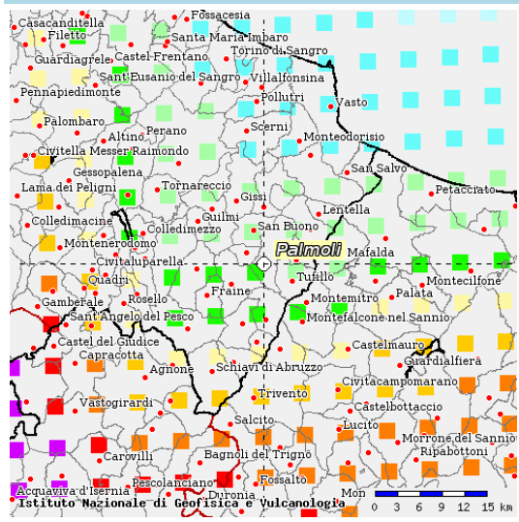
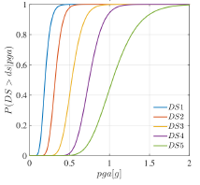
Trento, 02 December 2020
Ph.D. Student: Chiara Nardin
chiara.nardin@unitn.it
Introduction | Probabilistic Hazard Analysis | Fragility Analysis | References
Course outline:
Introduction
PBEE overview
the PEER-PBEE framework
Probabilistic Seismic Hazard Model
Concept and Formulation
Hazard Computation (MatLab)
Vulnerability and Fragility Analysis
Concept and Formulation
Fragility Computation (MatLab)
References
http://zonesismiche.mi.ingv.it/

Slide 3
Trento, 02 December 2020
Ph.D. Student: Chiara Nardin
chiara.nardin@unitn.it
Introduction
Performance Based Earthquake Engineering
Ph.D. Student Chiara Nardin – M.Sc., Eng. in Civil Engineering

Slide 4
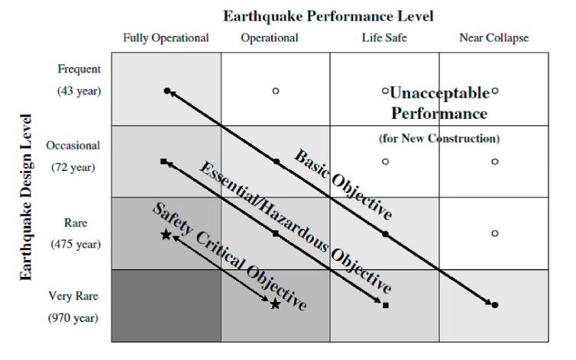
Trento, 02 December 2020
Ph.D. Student: Chiara Nardin
chiara.nardin@unitn.it
Introduction | Probabilistic Hazard Analysis | Fragility Analysis | References
PBEE: Performance Based Earthquake Engineering
Probabilistic framework for (i) assessing design, (ii) evaluation and (iii) planning of civil system.
load-and-resistence-factor design (LRFD)
performance based design (PBD):
3Ds – i.e. downtime, dollars, death
2 axes define the domain of acceptable system’s response:
System performance objectives
Seismic hazard level, w.r.t. return periods
Fig.1 – PBEE concept: seismic performance objectives vs seismic hazard level. ©Poland et al.,(1995)-Vision 2000: Performance Based Earthquake Engineering of buildings. Structural Engineers Association of California, Sacramento, CA.

Slide 5
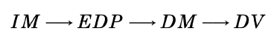
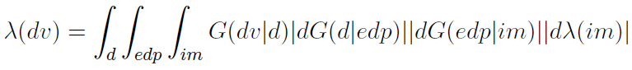

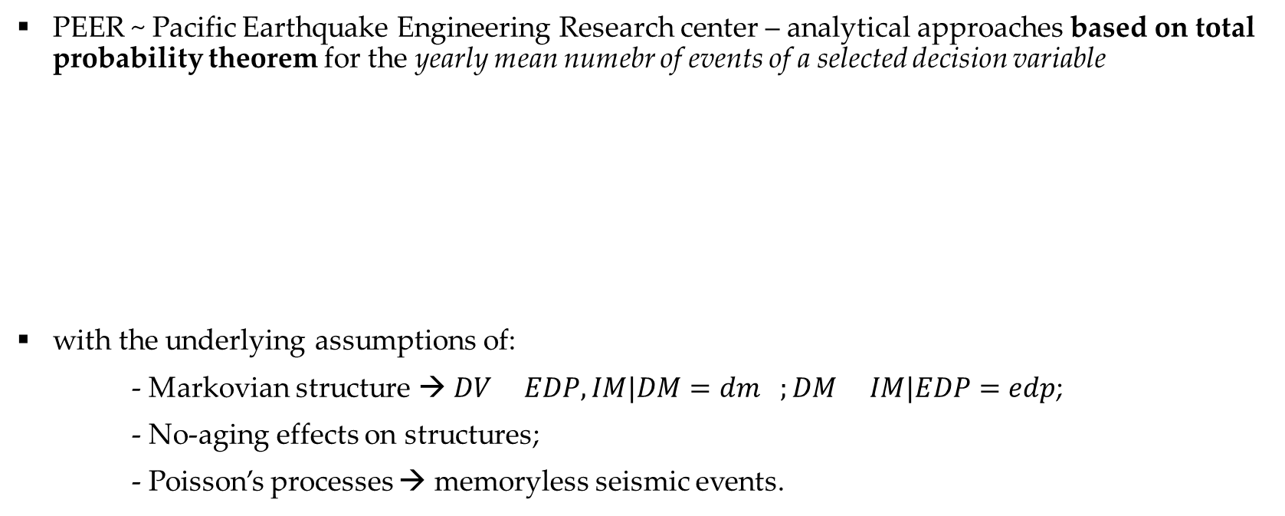
Trento, 02 December 2020
Ph.D. Student: Chiara Nardin
chiara.nardin@unitn.it
Introduction | Probabilistic Hazard Analysis | Fragility Analysis | References
The PEER-PBEE Framework
PEER ~ Pacific Earthquake Engineering Research center – analytical approaches based on total probability theorem for the yearly mean numebr of events of a selected decision variable
with the underlying assumptions of:
- Markovian structure → $DV EDP,IM|DM=dm ;DM IM|EDP=edp$;
- No-aging effects on structures;
- Poisson’s processes → memoryless seismic events.

Slide 6
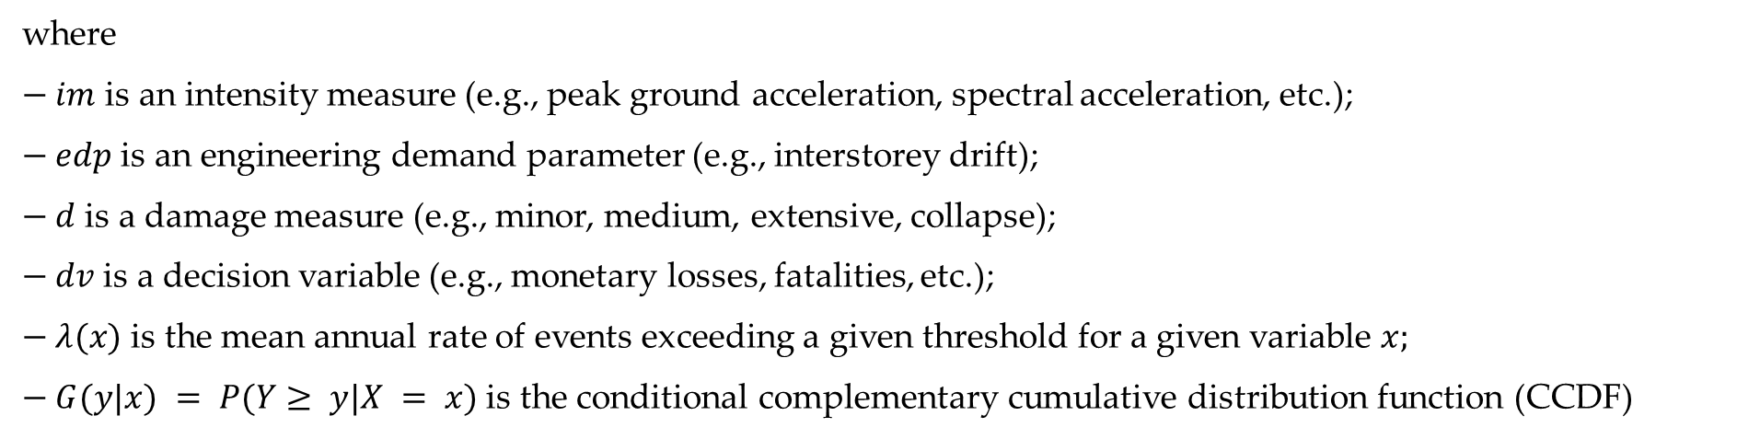
Trento, 02 December 2020
Ph.D. Student: Chiara Nardin
chiara.nardin@unitn.it
Introduction | Probabilistic Hazard Analysis | Fragility Analysis | References
The PEER-PBEE Framework
where
$− im$ is an intensity measure (e.g., peak ground acceleration, spectral acceleration, etc.);
$− edp$ is an engineering demand parameter (e.g., interstorey drift);
$− d$ is a damage measure (e.g., minor, medium, extensive, collapse);
$− dv$ is a decision variable (e.g., monetary losses, fatalities, etc.);
$− λ(x)$ is the mean annual rate of events exceeding a given threshold for a given variable $x;$
$− G(y|x) = P(Y≥ y|X = x)$ is the conditional complementary cumulative distribution function (CCDF)

Slide 7
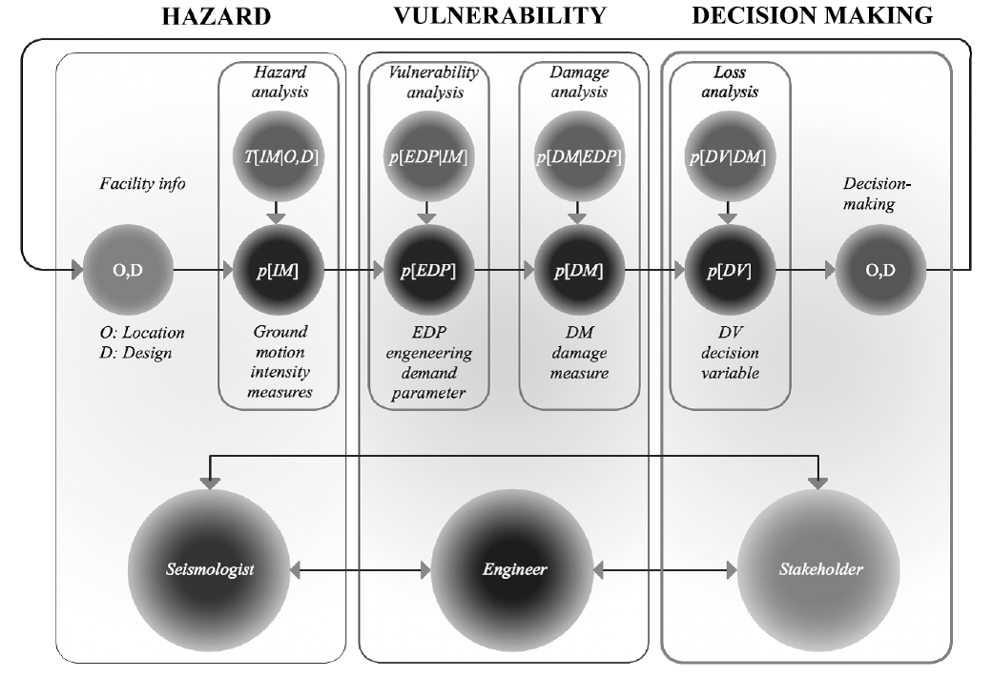
Trento, 02 December 2020
Ph.D. Student: Chiara Nardin
chiara.nardin@unitn.it
Introduction | Probabilistic Hazard Analysis | Fragility Analysis | References
The PEER-PBEE Framework
(i) hazard analysis
(ii) fragility analysis
(iii) damage analysis
(iv) loss analysis

Slide 8
Trento, 02 December 2020
Ph.D. Student: Chiara Nardin
chiara.nardin@unitn.it
Probabilistic Hazard Analysis
Formulation and MatLab Computation
Ph.D. Student Chiara Nardin – M.Sc., Eng. in Civil Engineering

Slide 9
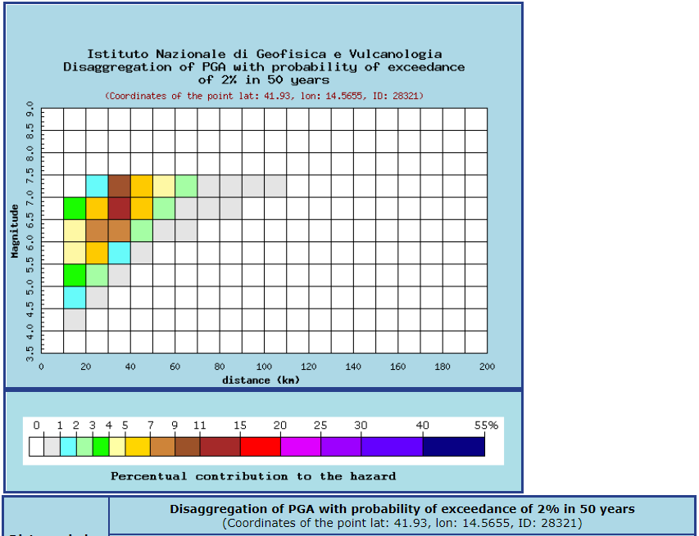
Trento, 09 October 2020
Ph.D. Student: Chiara Nardin
chiara.nardin@unitn.it
Introduction Probabilistic Hazard Model Laboratory
Course outline:
Introduction
Overview and applications
DSHA vs PSHA
Probabilistic Hazard Model
Earthquake Source Characterization
Earthquake Size
Ground Motion Estimation
Hazard Computation
Laboratory
http://zonesismiche.mi.ingv.it/

Slide 10
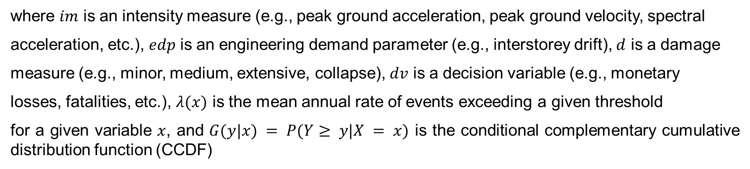
Trento, 09 October 2020
Ph.D. Student: Chiara Nardin
chiara.nardin@unitn.it
Introduction Probabilistic Hazard Model Laboratory
Seismic Hazard Analysis
where $im$ is an intensity measure (e.g., peak ground acceleration, peak ground velocity, spectral
acceleration, etc.), $edp$ is an engineering demand parameter (e.g., interstorey drift), $d$ is a damage
measure (e.g., minor, medium, extensive, collapse), $dv$ is a decision variable (e.g., monetary
losses, fatalities, etc.), $λ(x)$ is the mean annual rate of events exceeding a given threshold
for a given variable $x$, and $G(y|x) = P(Y≥ y|X = x)$ is the conditional complementary cumulative distribution function (CCDF)
Notes:
SHA is the basis for many earthquake design codes practices and for seismic risk analysis of civil systems.
total probability theorem for the yearly mean number of events of a selected decision
variable.
L’approccio proposto fornisce in output delle
misure quantitative della performance dell’edificio, fra cui in particolare una stima delle perdite
causate dall’evento sismico, quali ad esempio i costi di ricostruzione, l’interruzione di servizio
post-terremoto e il numero di vittime causate dal sisma, altresì note come le 3Ds - dollars, deaths,
downtime
livelli di performance sono quindi definiti in funzione di parametri decisionali detti appunto
decision variables - DVs. In generale, le DVs sono a loro volta funzioni di misure del danno
dette measure variables - DM, funzioni esse stesse di funzioni di domanda ingegneristica dette
engineering demand parameters - EDP, dipendenti da parametri di intensity measures - IM.
ogni freccia rappresenta un modello di relazione probabilistica condizionata.
Per esempio, un opportuno modello generatore di IM fornisce opportuni valori di EDP, mentre
un altro modello di danno fornisce vari DM a seconda dell’EDP in ingresso.

Slide 11


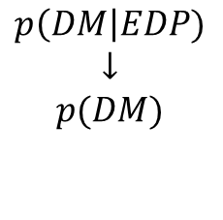
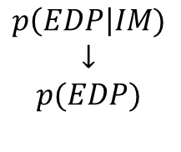
Trento, 09 October 2020
Ph.D. Student: Chiara Nardin
chiara.nardin@unitn.it
Introduction Probabilistic Hazard Model Laboratory
Seismic Hazard Analysis
Hazard analysis
intensity measure
Loss analysis
decision variable
HAZARD
VULNERABILITY
Damage analysis
damage measure
DECISION MAKING
VULNERABILITY
Vulnerability analysis
engineering demand par.
SHA is the basis for many earthquake design codes and for seismic risk analysis of civil systems.
Useful definitions:
seismic hazard := the exceedance (or occurrence) probability for a given ground motion intensity measure threshold, site and time interval
seismic risk:= the exceedance (or occurrence) probability for a given loss threshold, site and time interval.
$$p\left(IM\right|M,R)$$
$$↓$$
$$p(IM)$$
$$p\left(EDP\right|IM)$$
$$↓$$
$$p(EDP)$$
$$p\left(DM\right|EDP)$$
$$↓$$
$$p(DM)$$
$$p\left(DV\right|DM)$$
$$↓$$
$$p(DV)$$
Notes:
SHA is the basis for many earthquake design codes practices and for seismic risk analysis of civil systems.

Slide 12
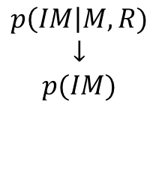
Trento, 09 October 2020
Ph.D. Student: Chiara Nardin
chiara.nardin@unitn.it
Introduction Probabilistic Hazard Model Laboratory
Seismic Hazard Analysis - Overview
Reliable SHA in order to minimize:
Loss of life;
Property damage;
Social and Economic disruption.
Base-ground for:
Seismic-structural design;
Financial-insurance policies;
Emergency-response policies;
Post-earthquake recovery.
Hazard analysis
intensity measure
$$p\left(IM\right|M,R)$$
$$↓$$
$$p(IM)$$
PBEE Framework !
HAZARD
https://peer.berkeley.edu/sites/default/files/web_peer10_02_sanaz_rezaeian_and_armen_der_kiureghian.pdf
Notes:
SHA is the basis for many earthquake design codes practices and for seismic risk analysis of civil systems.

Slide 13
Trento, 09 October 2020
Ph.D. Student: Chiara Nardin
chiara.nardin@unitn.it
Introduction Probabilistic Hazard Model Laboratory
DSHA
Evaluate the worst-case scenario
PSHA
Evaluate the exceedance probability of a given g.m. IM threshold at given site and time interval
Seismic Hazard Analysis – DSHA vs PSHA
PBEE Framework !
Four steps of a DSHA and PSHA analyses - Kramer, 1996
Notes:
SHA is the basis for many earthquake design codes practices and for seismic risk analysis of civil systems.

Slide 14
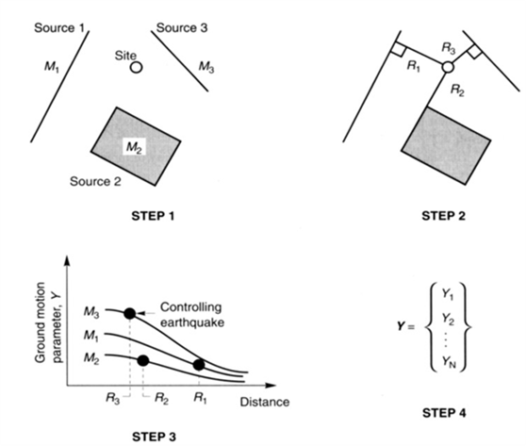
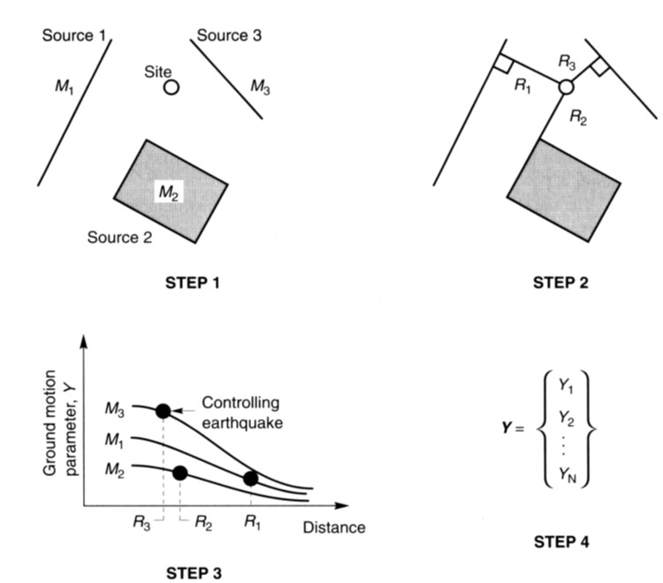
Trento, 09 October 2020
Ph.D. Student: Chiara Nardin
chiara.nardin@unitn.it
Introduction Probabilistic Hazard Model Laboratory
DSHA
Deterministic Seismic Hazard Analysis (DSHA) consists in the analysis of a particular seismic scenario. The output is the intensity level of the scenario: the occurrence of an earthquake of specific size at a given location.
i. Identification and Characterization of sources
ii. Selection of source to site distance
iii. Selection of master earthquake
iv. Hazard Computation
Definition of earthquake source’s geometry and earthquake potential
Evaluation of distance between source zone – site of interest
Generally described in terms of magnitude and distance from site
Usually described by one or more g.m. parameters.

Slide 15
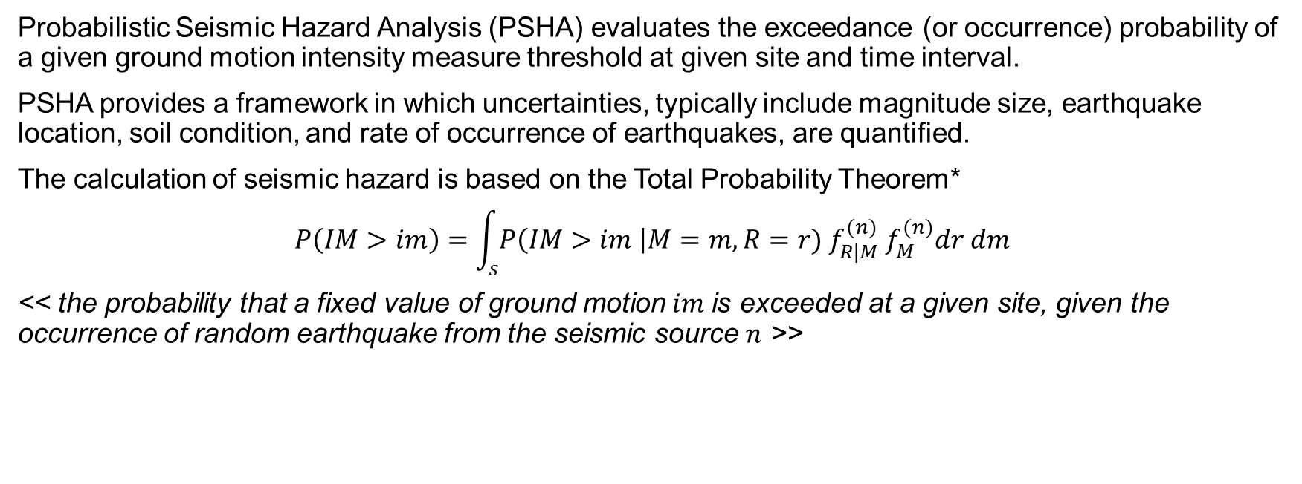
Trento, 09 October 2020
Ph.D. Student: Chiara Nardin
chiara.nardin@unitn.it
Introduction Probabilistic Hazard Model Laboratory
PSHA
Probabilistic Seismic Hazard Analysis (PSHA) evaluates the exceedance (or occurrence) probability of a given ground motion intensity measure threshold at given site and time interval.
PSHA provides a framework in which uncertainties, typically include magnitude size, earthquake location, soil condition, and rate of occurrence of earthquakes, are quantified.
The calculation of seismic hazard is based on the Total Probability Theorem*
$$P\left(IM>im\right)=\int_{s}{P\left(IM>im \right|M=m, R=r){ f}_{R|M}^{(n)} f_{M}^{(n)}dr dm}$$
<< the probability that a fixed value of ground motion$im$is exceeded at a given site, given the occurrence of random earthquake from the seismic source $n$ >>
(1)
*see Notes at the end of Presentation

Slide 16
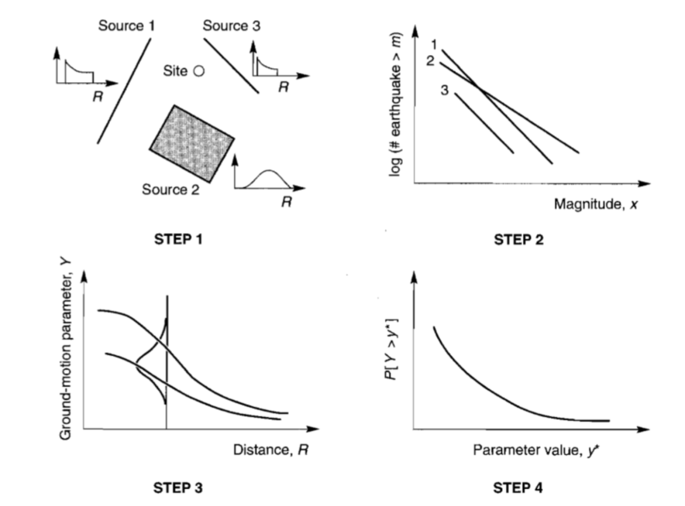
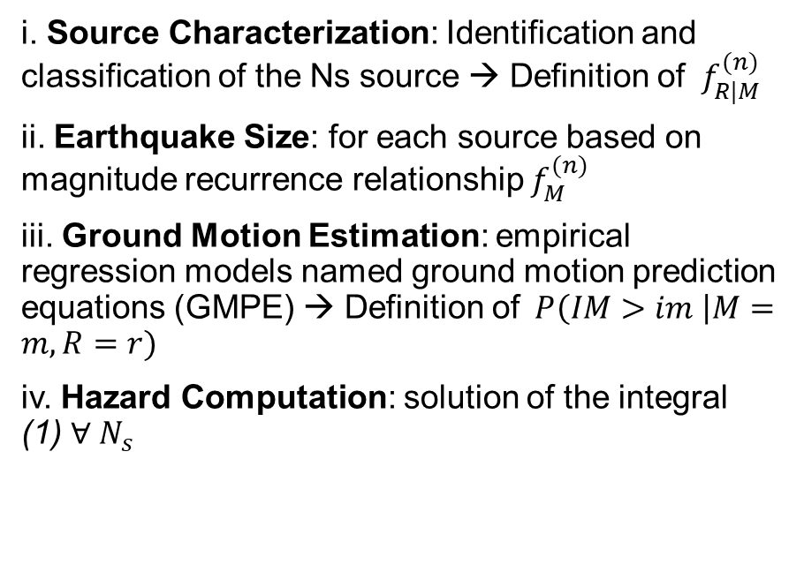
Trento, 09 October 2020
Ph.D. Student: Chiara Nardin
chiara.nardin@unitn.it
Introduction Probabilistic Hazard Model Laboratory
PSHA - Steps
i. Source Characterization: Identification and classification of the Ns source → Definition of ${ f}_{R|M}^{(n)}$
ii. Earthquake Size: for each source based on magnitude recurrence relationship $f_{M}^{(n)}$
iii. Ground Motion Estimation: empirical regression models named ground motion prediction equations (GMPE) → Definition of$P\left(IM>im \right|M=m, R=r)$
iv. Hazard Computation: solution of the integral (1) $∀ N_{s}$

Slide 17
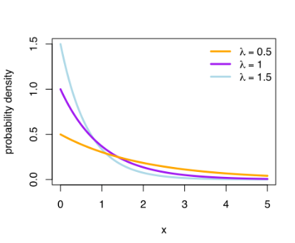
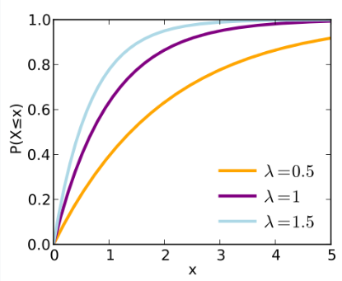
Trento, 09 October 2020
Ph.D. Student: Chiara Nardin
chiara.nardin@unitn.it
Introduction Probabilistic Hazard Model Laboratory
PSHA – Assumptions:
Eq. (1) is based on the following assumptions:
Earthquakes form a stochastic process;
Earthquakes can be considered instantaneous events and memory-less
the occurrence of earthquakes can be defined as Homogeneus Poisson Process (HPP)
PDF
CDF
exponential distribution of earthquake recurrence

Slide 18
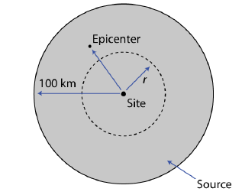
Trento, 09 October 2020
Ph.D. Student: Chiara Nardin
chiara.nardin@unitn.it
Introduction Probabilistic Hazard Model Laboratory
PSHA – Step 1: Earthquake source characterization
Goal: to identify
Fault sources: individual or multiple identified faults
Area sources: defined by polygons in which seismicity is assumed uniform
(Identification based upon the interpretation of geological, geophysical and seismological – historical data)
and to characterize seismic sources
Point source
Linear source
Area source
(the geometry of the source is used to identify the probability distribution of source-to-site distances)
SOURCES
DISTANCES

Slide 19
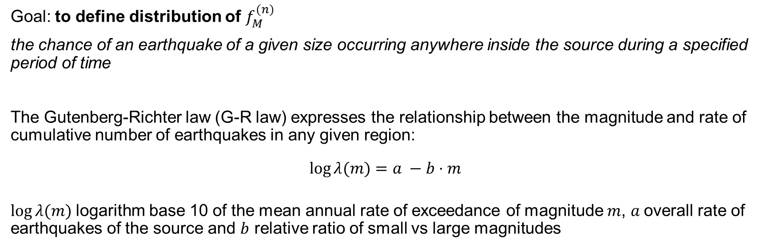
Trento, 09 October 2020
Ph.D. Student: Chiara Nardin
chiara.nardin@unitn.it
Introduction Probabilistic Hazard Model Laboratory
PSHA – Step 2: Earthquake size (Recurrence law)
Goal: to define distribution of $f_{M}^{(n)}$
the chance of an earthquake of a given size occurring anywhere inside the source during a specified period of time
The Gutenberg-Richter law (G-R law) expresses the relationship between the magnitude and rate of cumulative number of earthquakes in any given region:
$$\log{λ(m)}=a −b⋅m$$
$\log{λ(m)}$logarithm base 10 of the mean annual rate of exceedance of magnitude $m$, $a$overall rate of earthquakes of the source and $b$ relative ratio of small vs large magnitudes

Slide 20
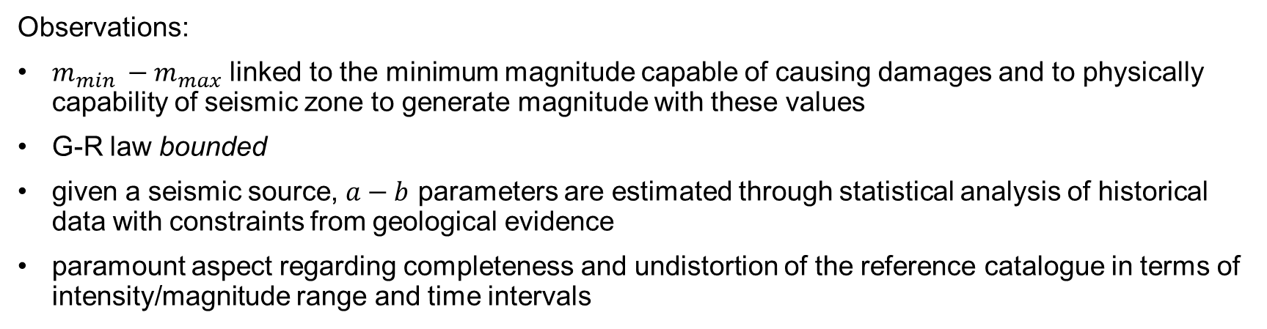
Trento, 09 October 2020
Ph.D. Student: Chiara Nardin
chiara.nardin@unitn.it
Introduction Probabilistic Hazard Model Laboratory
PSHA – Step 2: Earthquake size (Recurrence law)
Observations:
$m_{min} −m_{max}$ linked to the minimum magnitude capable of causing damages and to physically capability of seismic zone to generate magnitude with these values
G-R law bounded
given a seismic source, $a−b$ parameters are estimated through statistical analysis of historical data with constraints from geological evidence
paramount aspect regarding completeness and undistortion of the reference catalogue in terms of intensity/magnitude range and time intervals

Slide 21
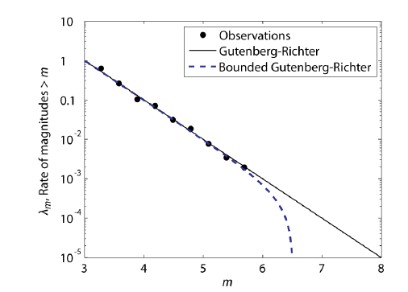
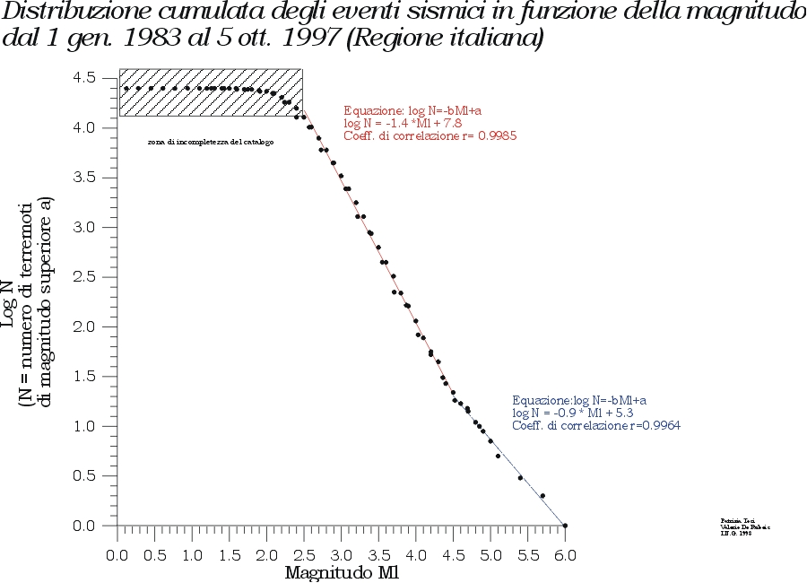
Trento, 09 October 2020
Ph.D. Student: Chiara Nardin
chiara.nardin@unitn.it
Introduction Probabilistic Hazard Model Laboratory
PSHA – Step 2: Earthquake size (Recurrence law)
Observations:
http://legacy.ingv.it/roma/attivita/pererischio/macrosismica/Seismic/seismic.html

Slide 22
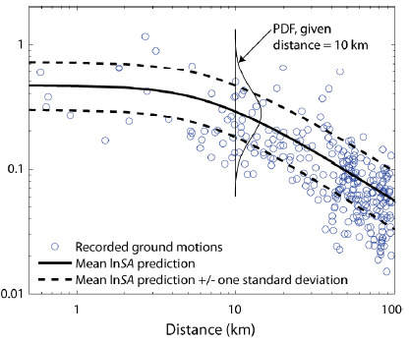
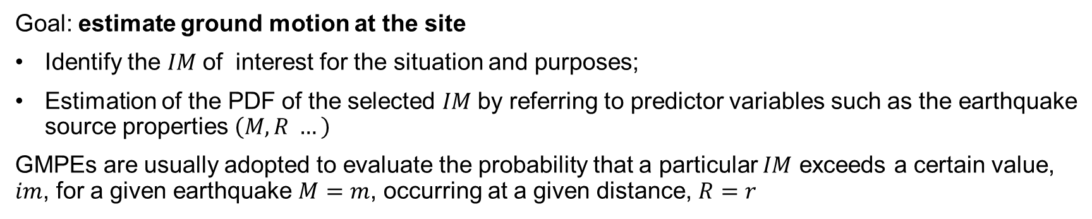
Trento, 09 October 2020
Ph.D. Student: Chiara Nardin
chiara.nardin@unitn.it
Introduction Probabilistic Hazard Model Laboratory
PSHA – Step 3: Ground motion predictive equations (GMPE)
Goal: estimate ground motion at the site
Identify the $IM$of interest for the situation and purposes;
Estimation of the PDF of the selected $IM$by referring to predictor variables such as the earthquake source properties $\left(M,R …\right)$
GMPEs are usually adopted to evaluate the probability that a particular $IM$ exceeds a certain value, $im$, for a given earthquake $M=m$, occurring at a given distance, $R=r$
Schematic illustration of conditional probability of exceeding a particular value of a
ground motion parameter for a given magnitude and distance.

Slide 23
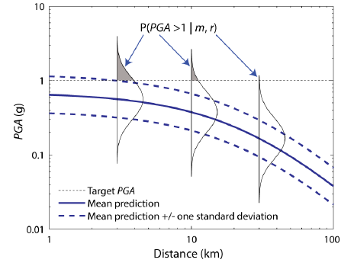
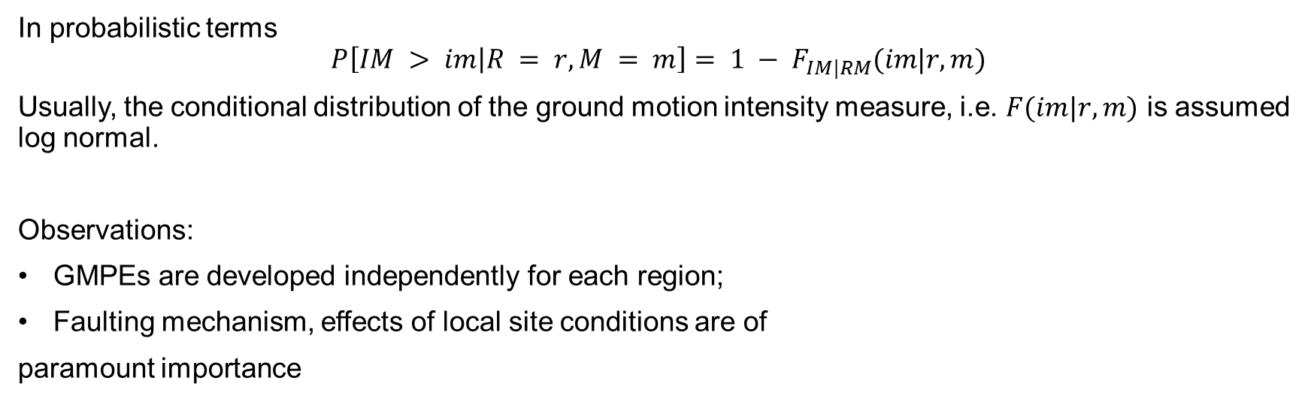
Trento, 09 October 2020
Ph.D. Student: Chiara Nardin
chiara.nardin@unitn.it
Introduction Probabilistic Hazard Model Laboratory
PSHA – Step 3: Ground motion predictive equations (GMPE)
In probabilistic terms
$$P\left[IM > im | R = r,M = m\right]= 1 − F_{IM|RM}(im|r,m)$$
Usually, the conditional distribution of the ground motion intensity measure, i.e. $F(im|r,m)$ is assumed log normal.
Observations:
GMPEs are developed independently for each region;
Faulting mechanism, effects of local site conditions are of
paramount importance
Schematic illustration of conditional probability of exceeding a particular value of a
ground motion parameter for a given magnitude and distance.

Slide 24
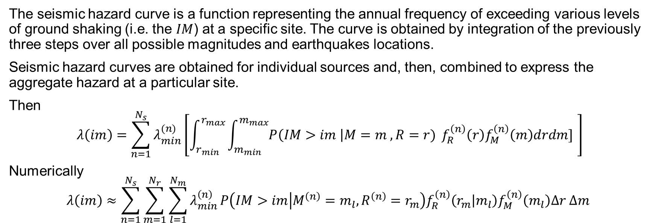
Trento, 09 October 2020
Ph.D. Student: Chiara Nardin
chiara.nardin@unitn.it
Introduction Probabilistic Hazard Model Laboratory
PSHA – Step 4: Hazard Computation
The seismic hazard curve is a function representing the annual frequency of exceeding various levels of ground shaking (i.e. the $IM$) at a specific site. The curve is obtained by integration of the previously three steps over all possible magnitudes and earthquakes locations.
Seismic hazard curves are obtained for individual sources and, then, combined to express the aggregate hazard at a particular site.
Then
$$λ\left(im\right)=\sum_{n=1}^{N_{s}}{λ_{min}^{(n)}}\left[\int_{r_{min}}^{r_{max}}{\int_{m_{min}}^{m_{max}}{P\left(IM>im \right|M=m , R=r)}} f_{R}^{\left(n\right)}\left(r\right)f_{M}^{\left(n\right)}\left(m\right)drdm] \right]$$
Numerically
$$λ\left(im\right)≈\sum_{n=1}^{N_{s}}{\sum_{m=1}^{N_{r}}{\sum_{l=1}^{N_{m}}{λ_{min}^{\left(n\right)}}P\left(IM>im | M^{\left(n\right)}=m_{l}, R^{\left(n\right)}=r_{m}\right)f_{R}^{\left(n\right)}\left(r_{m} | m_{l}\right)f_{M}^{\left(n\right)}\left(m_{l}\right)Δr Δm} }$$
(2)
(3)

Slide 25
Trento, 09 October 2020
Ph.D. Student: Chiara Nardin
chiara.nardin@unitn.it
Introduction Probabilistic Hazard Model Laboratory
References
Baker J. W. (2008). An Introduction to Probabilistic Seismic Hazard Analysis (PSHA), White Paper, Version 1.3, 72 pp.
Kramer, S.L. (1996) Geotechnical earthquake engineering. Prentice Hall, Upper Saddle River, N.J.
Wells, D.L. and Coppersmith, K.J. (1994) New empirical relationships among magnitude, rupture length, rupture width, rupture area, and surface displacement. Bull. Seism. Soc. Am., 84, 974-1002.
Cornell, C.A. (1968). Engineering seismic risk analysis, Bull. Seism. Soc. Am., 58, 1583-1606.
Broccardo, M. (2018) Probabilistic seismic risk analysis for civil systems, Lecture Notes

Slide 26

Trento, 09 October 2020
Ph.D. Student: Chiara Nardin
chiara.nardin@unitn.it
Ingegneria Sismica e Progettazione Strutturale
PSHA – Assignment 1
Ph.D. Candidate Chiara Nardin – M.Sc., Eng. in Civil Engineering
https://github.com/kia13nn/ISPS.git

Slide 27
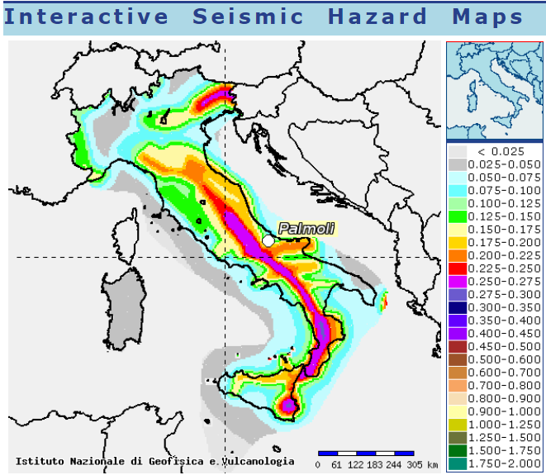
Trento, 09 October 2020
Ph.D. Student: Chiara Nardin
chiara.nardin@unitn.it
Introduction Probabilistic Hazard Model Laboratory
Goal: to perform a PSHA analysis
Through the scheme depicted in (1), compute:
the annual hazard curve for each fault;
the 50 years hazard curve for each fault;
the 475 years hazard curve for each fault
for the highlighted seismic site.
http://esse1-gis.mi.ingv.it/
Seismic hazard map: shaking parameter PGA, site Palmoli (CH) Latitude 41,527 – Longitude 14,483.

Slide 28
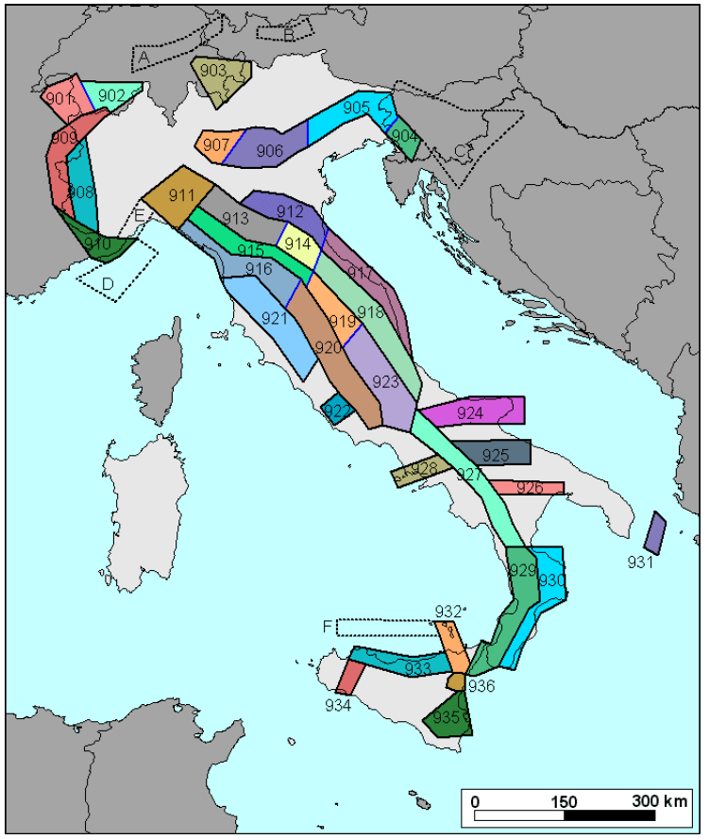
Trento, 09 October 2020
Ph.D. Student: Chiara Nardin
chiara.nardin@unitn.it
Introduction Probabilistic Hazard Model Laboratory
Step 1: Source characterization
Localize seismogenetic zones: Italian ZS9* model for application of the attenuation law
Different characteristics of zonation by:
Seismogenetic faults and mechanisms (direct, inverse, strike-slip …)
Hypocenter depth (shallow, intermediate, deep)
ect.
Italian database and catalogue of the overall seismicity
http://zonesismiche.mi.ingv.it/

Slide 29
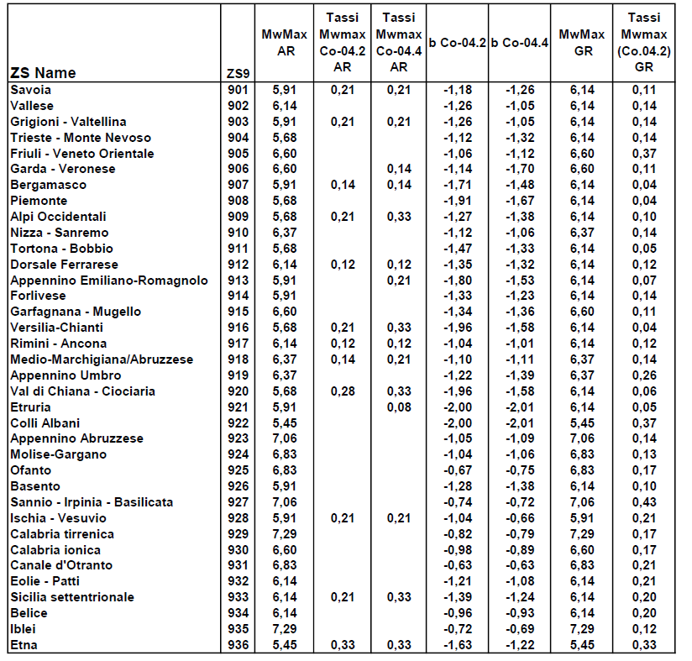
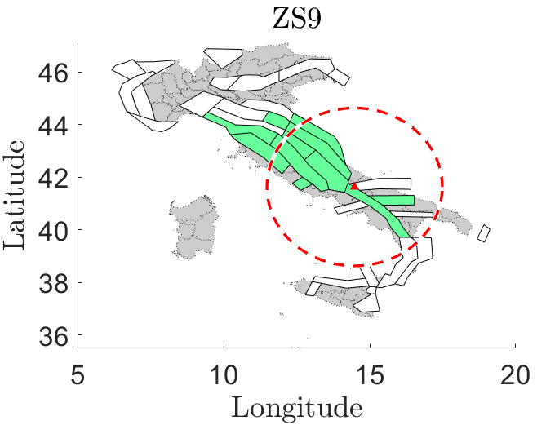
Trento, 09 October 2020
Ph.D. Student: Chiara Nardin
chiara.nardin@unitn.it
Introduction Probabilistic Hazard Model Laboratory
Step 1: Source characterization
Localize seismogenetic zones: Italian ZS9* model for application of the attenuation law
http://zonesismiche.mi.ingv.it/

Slide 30
Trento, 09 October 2020
Ph.D. Student: Chiara Nardin
chiara.nardin@unitn.it
Introduction Probabilistic Hazard Model Laboratory
Step 1: Source characterization
Extrapolate information regarding the source and its bound limits: convert coordinates from deg2utm for each sources
 | Coordinates
 | WGS 84 |  | UTM |  | UTM-Z
Location | long (x) | lat (y)
Palmoli | 14,48 | 41,63 | 465.293 | 4643124 | 33 T
ZS9-918 | S1
WGS 84 |  | UTM |  | UTM-Z | UTM-INPORT
12,11651 | 43,79397 | 268015,9 | 4853032 | 33 T | -197.277 | 209.907
12,27012 | 44,10645 | 281523,5 | 4887320 | 33 T | -183.769 | 244.196
13,54116 | 43,2943 | 381660,3 | 4794530 | 33 T | -83.633 | 151.405
14,181 | 42,47483 | 432678,9 | 4702824 | 33 T | -32.614 | 59.699
14,37249 | 42,14993 | 448153,3 | 4666614 | 33 T | -17.140 | 23.489
14,27923 | 41,85719 | 440174,4 | 4634171 | 33 T | -25.118 | -8.953
13,1518 | 43,02822 | 349423 | 4765606 | 33 T | -115.870 | 122.481
12,11651 | 43,79397 | 268015,9 | 4853032 | 33 T | -197.277 | 209.907
Source | b | Mw Max | Mw Min | Rate
S1 | -1,11 | 6,37 | 4,76 | 0,21
S2 | -1,09 | 7,06 | 4,76 | 0,14
… | … | … | … | …

Slide 31
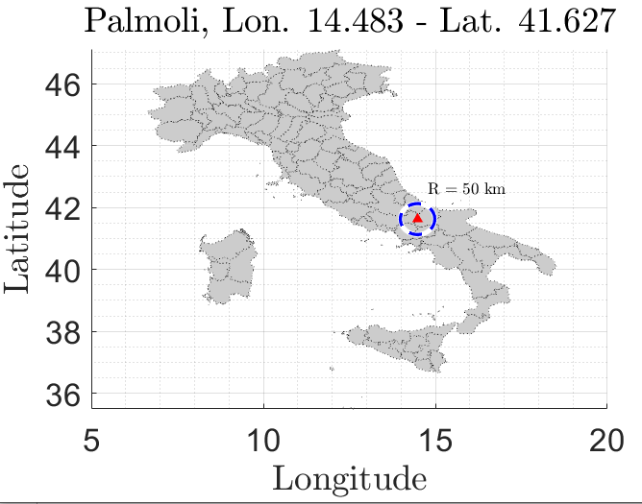
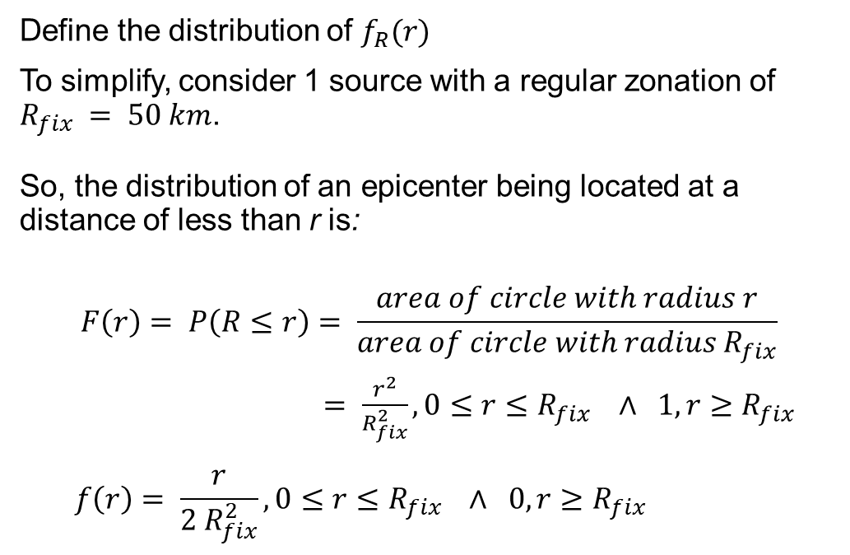
Trento, 09 October 2020
Ph.D. Student: Chiara Nardin
chiara.nardin@unitn.it
Introduction Probabilistic Hazard Model Laboratory
Step 1: Source characterization - Location
Define the distribution of $f_{R}(r)$
To simplify, consider 1 source with a regular zonation of $R_{fix} = 50 km$.
So, the distribution of an epicenter being located at a distance of less than r is:
$$F\left(r\right)= P\left(R≤r\right)= \frac{area of circle with radius r}{area of circle with radius R_{fix}}$$
$= \frac{r^{2}}{R_{fix}^{2}}, 0≤r≤R_{fix} ∧ 1, r≥R_{fix}$
$$f\left(r\right)= \frac{r}{{2 R}_{fix}^{2}}, 0≤r≤R_{fix} ∧ 0, r≥R_{fix}$$
CDF:
PDF:

Slide 32
Trento, 09 October 2020
Ph.D. Student: Chiara Nardin
chiara.nardin@unitn.it
Introduction Probabilistic Hazard Model Laboratory
Step 1: Source characterization
Codes:
Read source.xls file
Run section Earthquake source characterization in the attached Matlab code or load variable seismic_source.mat already prepared with the previously seen data

Slide 33
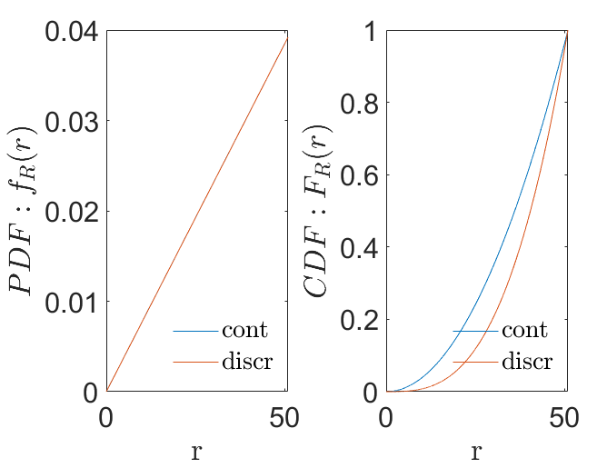
Trento, 09 October 2020
Ph.D. Student: Chiara Nardin
chiara.nardin@unitn.it
Introduction Probabilistic Hazard Model Laboratory
Step 1: Source characterization - Location
Codes:
% PDF of R
rmax = Rmax*100; % 50km
rmin = Rmin.*100; % site
r_step = R_step;
r = rmin:r_step:(rmax-r_step);
Fr = r.^2./rmax.^2;
fr = 2*r./rmax.^2;
DFr = r_step;
frdiscr = zeros(1,numel(Fr));
Frdiscr = zeros(1,numel(Fr));
for idr = 2:numel(Fr)
frdiscr(idr) = -(Fr(idr-1)-Fr(idr))./(DFr);
Frdiscr(idr) = Frdiscr(idr-1)+Fr(idr);
end

Slide 34
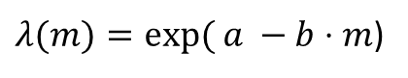
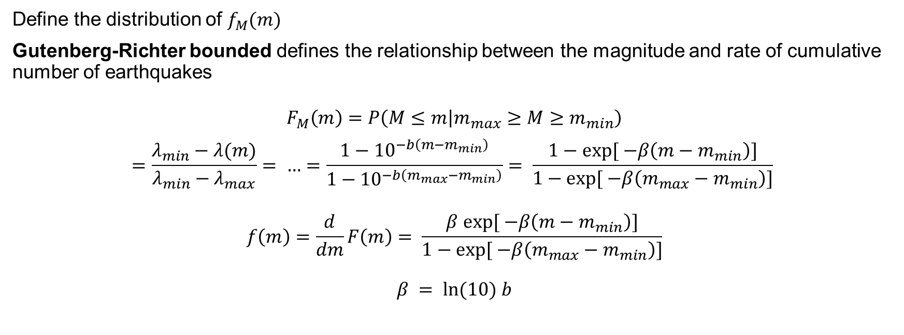
Trento, 09 October 2020
Ph.D. Student: Chiara Nardin
chiara.nardin@unitn.it
Introduction Probabilistic Hazard Model Laboratory
Step 2: Earthquake size
$λ(m)=exp⁡( a −b⋅m$)
Define the distribution of $f_{M}(m)$
Gutenberg-Richter bounded defines the relationship between the magnitude and rate of cumulative number of earthquakes
$$F_{M}\left(m\right)=P\left(M≤m | m_{max}≥M≥m_{min}\right)$$
$$=\frac{λ_{min}−λ(m)}{λ_{min}−λ_{max}}= …=\frac{1−{10}^{−b\left(m−m_{min}\right)}}{1−{10}^{−b\left(m_{max}−m_{min}\right)}}= \frac{1−exp⁡[ −β\left(m−m_{min}\right)]}{1−exp⁡[ −β\left(m_{max}−m_{min}\right)]}$$
$$f\left(m\right)=\frac{d}{dm}F\left(m\right)= \frac{β exp⁡[ −β\left(m−m_{min}\right)]}{1−exp⁡[ −β\left(m_{max}−m_{min}\right)]}$$
$$β = ln⁡(10) b$$
CDF:
PDF:

Slide 35
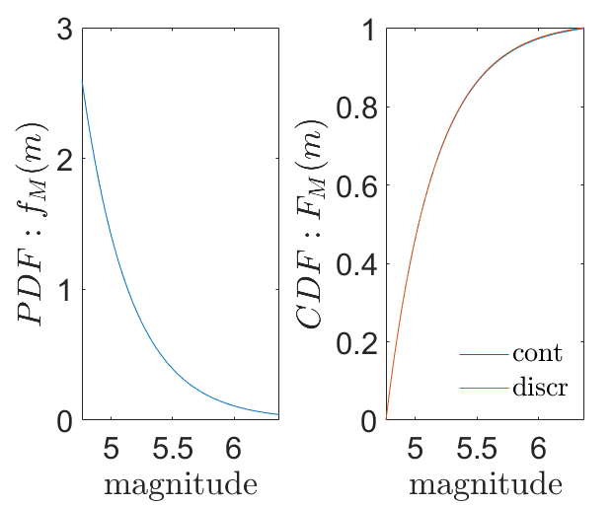

Trento, 09 October 2020
Ph.D. Student: Chiara Nardin
chiara.nardin@unitn.it
Introduction Probabilistic Hazard Model Laboratory
Step 2: Earthquake size
Define the distribution of $f_{M}(m)$: Discretize
Converting the continuous distribution of magnitudes into a discrete set of magnitudes holds
$$P\left(M=m_{j}\right)=F_{M}\left(m_{j+1}\right)−F_{M}(m_{j})$$
where $m_{j}$ are the discrete set of magnitudes ordered so that $m_{j+1}<m_{j}$
Codes:
% PDF of M
Nm = 1000; % No. of discretized points between m0 and mu for numerical integration
M = linspace(m0,mu,Nm); %mo = m_min
fM = beta*exp(-beta*(M-m0))/(1-exp(-beta*(mu-m0)));
dM=M(2)-M(1);
Mdiscr=fM*dM;

Slide 36
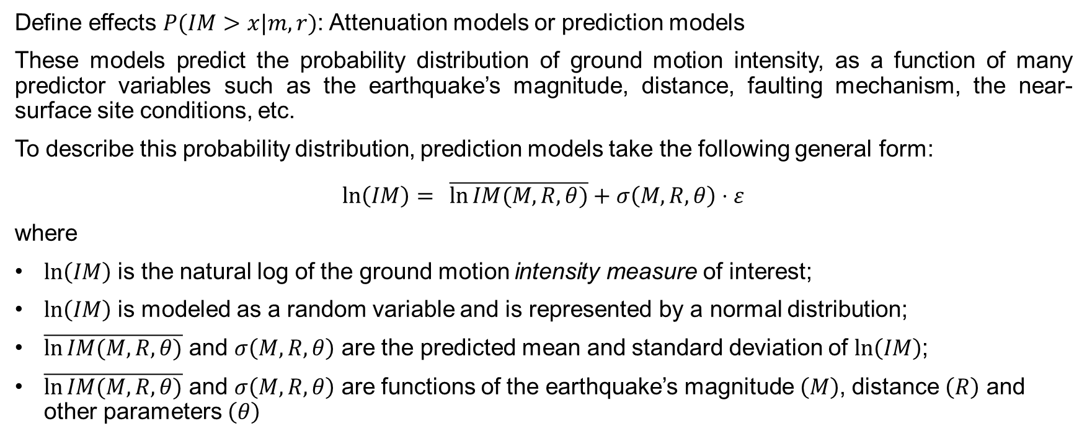
Trento, 09 October 2020
Ph.D. Student: Chiara Nardin
chiara.nardin@unitn.it
Introduction Probabilistic Hazard Model Laboratory
Step 3: Ground motion estimation
Define effects $P(IM>x|m,r)$: Attenuation models or prediction models
These models predict the probability distribution of ground motion intensity, as a function of many predictor variables such as the earthquake’s magnitude, distance, faulting mechanism, the near-surface site conditions, etc.
To describe this probability distribution, prediction models take the following general form:
$$\ln\left(IM\right)= \overline{\ln{IM(M,R,θ)}}+σ\left(M,R,θ\right)⋅ε$$
where
$ln\left(IM\right)$ is the natural log of the ground motion intensity measure of interest;
$ln\left(IM\right)$ is modeled as a random variable and is represented by a normal distribution;
$\overline{\ln{IM(M,R,θ)}}$ and $σ\left(M,R,θ\right)$ are the predicted mean and standard deviation of $ln\left(IM\right)$;
$\overline{\ln{IM(M,R,θ)}}$ and $σ\left(M,R,θ\right)$ are functions of the earthquake’s magnitude $\left(M\right)$, distance $\left(R\right)$ and other parameters $\left(θ\right)$

Slide 37

Trento, 09 October 2020
Ph.D. Student: Chiara Nardin
chiara.nardin@unitn.it
Introduction Probabilistic Hazard Model Laboratory
Step 3: Ground motion estimation
Define effects $P(IM>x|m,r)$: Attenuation models or prediction models
Here, for clarity, it is assumed Cornell (1979) for the mean of log peak ground acceleration (in units of g):
$$\overline{\ln{PGA}}=−0,152+0,859M −1,803 ln⁡(R+25)$$
with
$σ=0,57$ of $ln⁡(PGA)$;
$ln⁡(PGA)$ normally distributed

Slide 38

Trento, 09 October 2020
Ph.D. Student: Chiara Nardin
chiara.nardin@unitn.it
Introduction Probabilistic Hazard Model Laboratory
Step 3: Ground motion estimation
Define effects $P(IM>x|m,r)$: Attenuation models or prediction models
We can thereby compute the probability of exceeding any PGA level using knowledge of this mean and standard deviation:
$$P\left(PGA>x | m,r\right)=1−Φ\left(\frac{\ln{x −\ln{\overline{PGA}}}}{σ_{\ln\left(PGA\right)}}\right)$$
where $Φ\left( \right)$is the standard normal cumulative distribution function.
N.B.: these probabilities correspond to the fraction
of the corresponding PDFs that are shaded.

Slide 39

Trento, 09 October 2020
Ph.D. Student: Chiara Nardin
chiara.nardin@unitn.it
Introduction Probabilistic Hazard Model Laboratory
Step 3: Ground motion estimation
Define effects $P(IM>x|m,r)$: Attenuation models or prediction models
Codes:
function [mean_im, sigma_im] = GMPE(magnitude,R_distance)
%Cornell et al. (1979): Ground motion predictive equation for PGA
mean_lnPGA = -0.152+0.859*magnitude -1.803*log(R_distance+25);
mean_PGA = exp(mean_lnPGA);
mean_im = mean_PGA;
sigma_im = 0.57;
end

Slide 40
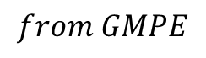



Trento, 09 October 2020
Ph.D. Student: Chiara Nardin
chiara.nardin@unitn.it
Introduction Probabilistic Hazard Model Laboratory
Step 4: Hazard Computation
Combine all information: compute $∫∫∫$
Compute the probability of exceeding an IM intensity level x, given occurrence of a future earthquake from a single source:
$$P\left(IM>x\right)=\int_{r_{min}}^{r_{max}}{\int_{m_{min}}^{m_{max}}{P\left(IM>im \right|M=m , R=r)}} f_{R}^{\left(n\right)}\left(r\right)f_{M}^{\left(n\right)}\left(m\right)drdm$$
II. Compute the rate of IM > x for each single source:
$$λ \text{(}\text{IM} \text{> }\text{x}\text{)} \text{=} λ(M>m_{min})\int_{r_{min}}^{r_{max}}{\int_{m_{min}}^{m_{max}}{P\left(IM>im \right|M=m , R=r)}} f_{R}^{\left(n\right)}\left(r\right)f_{M}^{\left(n\right)}\left(m\right)drdm$$
$$from GMPE$$
$$PDF of R$$
$$PDF of M$$

Slide 41

Trento, 09 October 2020
Ph.D. Student: Chiara Nardin
chiara.nardin@unitn.it
Introduction Probabilistic Hazard Model Laboratory
Step 4: Hazard Computation
Combine all information: compute $∫∫∫$
III. Considering all sources by the sum of the rates of IM > x from each individual source, we can write:
$$λ\left(IM>x\right)=\sum_{i=1}^{n_{sources}}{λ(M_{i}>m_{min})\int_{r_{min}}^{r_{max}}{\int_{m_{min}}^{m_{max}}{P\left(IM>im \right|M=m , R=r)}} f_{R_{i}}^{\left(n\right)}\left(r\right)f_{M_{i}}^{\left(n\right)}\left(m\right)drdm }$$
where $n_{sources}$ is the number of sources considered, and $M_{i} \sim R_{i}$ denote the magnitude ~ distance
distributions for source i
Notes:
$$λ(M>m_{min})\int_{r_{min}}^{r_{max}}{\int_{m_{min}}^{m_{max}}{P\left(IM>im \right|M=m , R=r)}} f_{R}^{\left(n\right)}\left(r\right)f_{M}^{\left(n\right)}\left(m\right)drdm$$

Slide 42

Trento, 09 October 2020
Ph.D. Student: Chiara Nardin
chiara.nardin@unitn.it
Introduction Probabilistic Hazard Model Laboratory
Step 4: Hazard Computation
Combine all information: compute $∫∫∫$ - Discretize
IV. By discretizing:
$${λ\left(im\right)≈\sum_{n=1}^{N_{s}}{\sum_{m=1}^{N_{r}}{\sum_{l=1}^{N_{m}}{λ_{min}^{\left(n\right)}}P\left(IM>im | M^{\left(n\right)}=m_{l}, R^{\left(n\right)}=r_{m}\right)P\left(R^{\left(n\right)}=r_{m} | m_{l}\right)P(M^{(n)}=m_{l})} }}_{}$$
where the range of possible $M_{i}$ and $R_{i}$ have been discretized into $n_{M}$ and $n_{R}$ intervals, respectively
Notes:
$$λ(M>m_{min})\int_{r_{min}}^{r_{max}}{\int_{m_{min}}^{m_{max}}{P\left(IM>im \right|M=m , R=r)}} f_{R}^{\left(n\right)}\left(r\right)f_{M}^{\left(n\right)}\left(m\right)drdm$$

Slide 43

Trento, 09 October 2020
Ph.D. Student: Chiara Nardin
chiara.nardin@unitn.it
Introduction Probabilistic Hazard Model Laboratory
Step 4: Hazard Computation
Goal and results
Through the scheme depicted in (1), compute:
the annual hazard curve for each fault;
the 50 years hazard curve for each fault;
the 475 years hazard curve for each fault
for the highlighted seismic site.
Notes:
$$λ(M>m_{min})\int_{r_{min}}^{r_{max}}{\int_{m_{min}}^{m_{max}}{P\left(IM>im \right|M=m , R=r)}} f_{R}^{\left(n\right)}\left(r\right)f_{M}^{\left(n\right)}\left(m\right)drdm$$

Slide 44


Trento, 09 October 2020
Ph.D. Student: Chiara Nardin
chiara.nardin@unitn.it
Introduction Probabilistic Hazard Model Laboratory
Step 4: Hazard Computation
Notes:
$$λ(M>m_{min})\int_{r_{min}}^{r_{max}}{\int_{m_{min}}^{m_{max}}{P\left(IM>im \right|M=m , R=r)}} f_{R}^{\left(n\right)}\left(r\right)f_{M}^{\left(n\right)}\left(m\right)drdm$$

Slide 45
Trento, 09 October 2020
Ph.D. Student: Chiara Nardin
chiara.nardin@unitn.it
Introduction Probabilistic Hazard Model Laboratory
Summary
Location
$P=1−e^{−λt}$ Poisson model
𝑃=1−𝑒^(−𝜆𝑡) Poisson model
Size
Time
$f_{R}\left(r\right)$ source site distance
𝑓_𝑅 (𝑟) source site distance
GMPE
$f_{M}\left(m\right)$ magnitude distribution
𝑓_𝑀 (𝑚) magnitude distribution
$P\left(IM>im \right|M=m , R=r)$ attenuation law
𝑃(𝐼𝑀>𝑖𝑚 ┤|𝑀=𝑚 , 𝑅=𝑟) attenuation law
Notes:
$$λ(M>m_{min})\int_{r_{min}}^{r_{max}}{\int_{m_{min}}^{m_{max}}{P\left(IM>im \right|M=m , R=r)}} f_{R}^{\left(n\right)}\left(r\right)f_{M}^{\left(n\right)}\left(m\right)drdm$$

Slide 46
Trento, 09 October 2020
Ph.D. Student: Chiara Nardin
chiara.nardin@unitn.it
Introduction Probabilistic Hazard Model Laboratory
References
Stucchi M., Meletti C., Montaldo V., Akinci A., Faccioli E., Gasperini P., Malagnini L., Valensise G. (2004). Pericolosità sismica di riferimento per il territorio nazionale MPS04. Istituto Nazionale di Geofisica e Vulcanologia (INGV). https://doi.org/10.13127/sh/mps04/agKramer, S.L. (1996) Geotechnical earthquake engineering. Prentice Hall, Upper Saddle River, N.J.
http://zonesismiche.mi.ingv.it/ → Italian database

Slide 47





Trento, 09 October 2020
Ph.D. Student: Chiara Nardin
chiara.nardin@unitn.it
Probability Theory
See also: https://en.wikipedia.org/wiki/PDF
Total Probability Theorem:
$$P\left[Y\right]= \sum_{i=1}^{n}{P\left[Y | X_{i}\right]P[X_{i}]}$$
Individual probabilities → Probability Density Function (PDF), $f(x)$
Uniform Distribution Normal Distribution Lognormal Distribution

Slide 48

Trento, 09 October 2020
Ph.D. Student: Chiara Nardin
chiara.nardin@unitn.it
Probability Theory
See also: https://en.wikipedia.org/wiki/PDF
$$F\left(x\right)=∫f\left(x\right)dx=Φ\left[\frac{x−μ_{x}}{σ_{x}}\right]$$
Standard Normal CDF
Z-Value
Probabilities of exceeding or not exceeding given values i
Uniform Distribution Normal Distribution Lognormal Distribution

